Slide 1
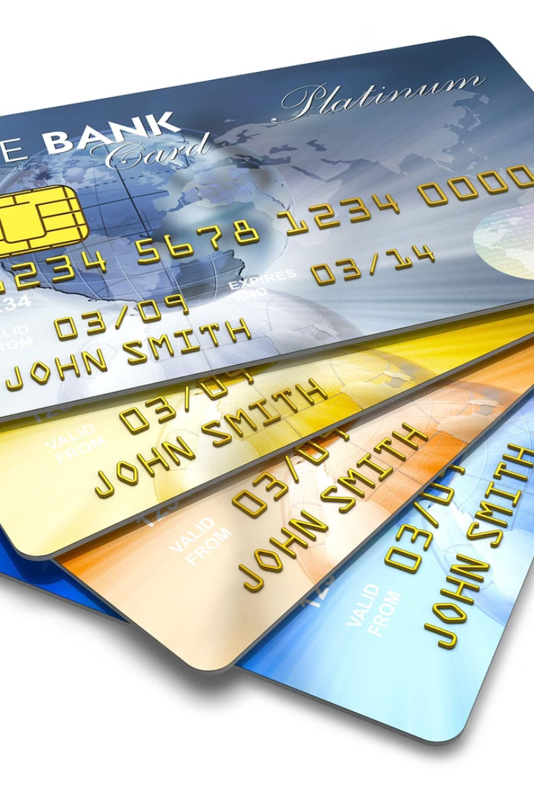

CREDIT CARDS – GOOD OR BAD?
A credit card is a small plastic or metal card that allows you to borrow money from the bank to make purchases. You must pay back the borrowed money later.
Credit cards can be good or bad, depending on how you use them.
by Ram N Java

Slide 2

ADVANTAGES OF CREDIT CARDS (GOOD SIDE)
1
Easy to Use
2
Buy Now, Pay Later
You don't need to carry cash. You can pay quickly in stores or online.
You can purchase something now and pay for it later.
3
Builds Credit Score
4
Rewards and Cashback
If you pay your bills on time, your credit score will improve, helping you get loans in the future.
Many credit cards give discounts, cashback, or points for shopping, travel, and fuel.

Slide 3
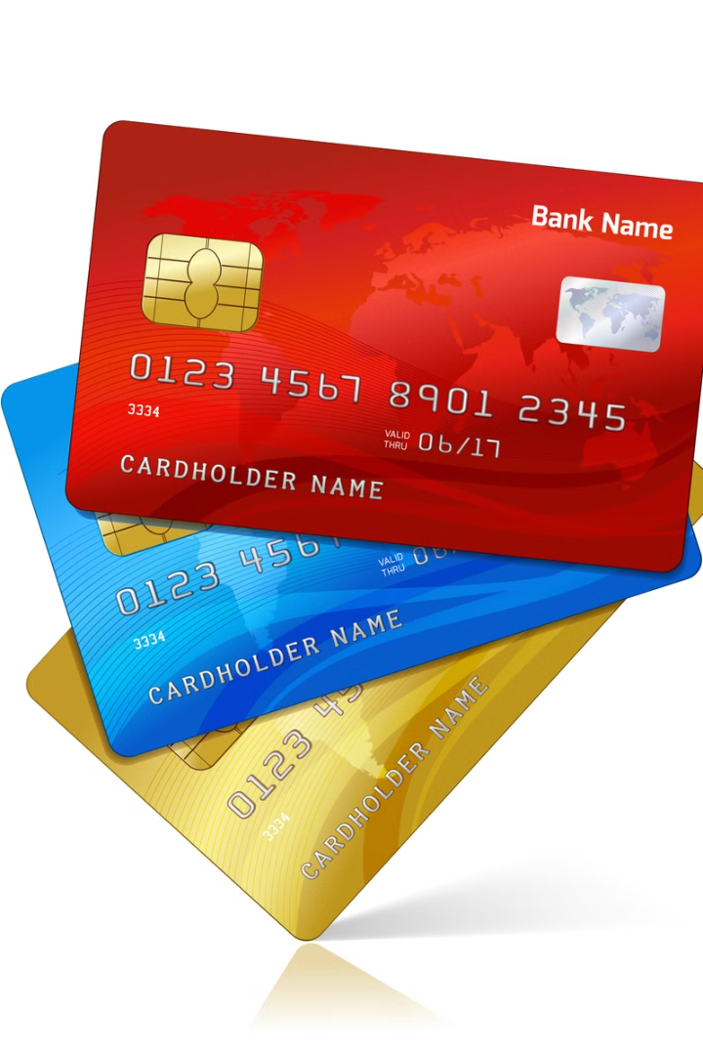



MORE ADVANTAGES OF CREDIT CARDS
Emergency Help
Safe Transactions
Accepted Worldwide
Useful in emergencies when you don't have enough cash.
Credit cards protect against fraud and offer security for online purchases.
You can use them almost anywhere, even in different countries.

Slide 4
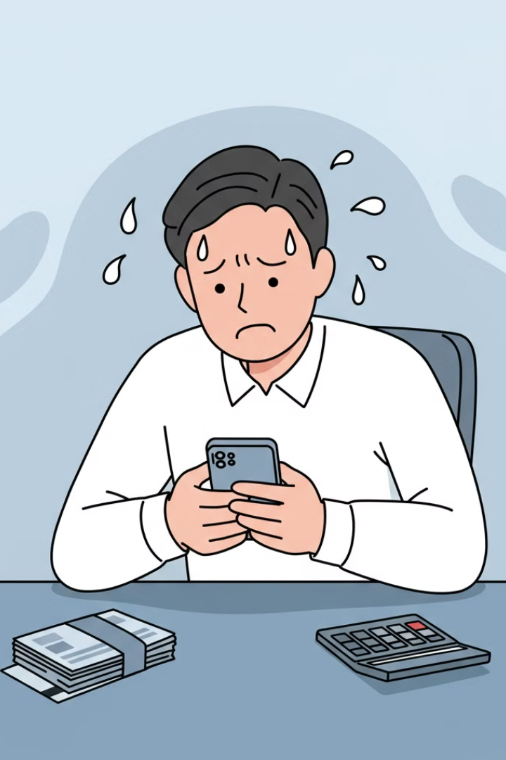



DISADVANTAGES OF
CREDIT CARDS (BAD SIDE)
High Interest Rates
If you don't pay your bill on time, you have to pay extra money as interest, which can be very expensive.
Debt Trap
Spending more than you can afford can lead to a lot of debt, making it hard to repay.
Late Fees and Charges
Missing payments leads to extra charges, which increases your debt.

Slide 5
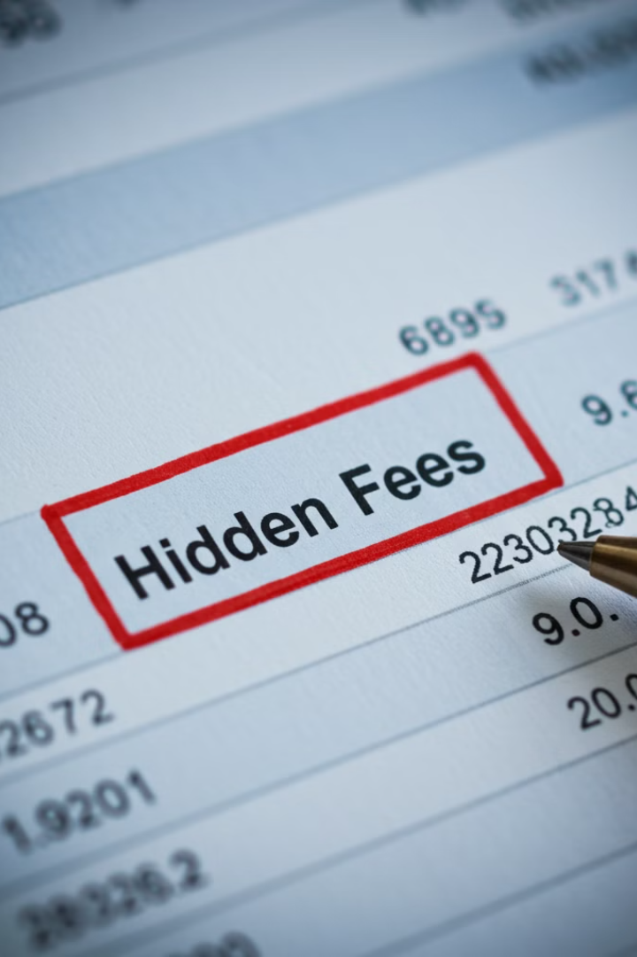
MORE DISADVANTAGES OF CREDIT CARDS
Encourages Overspending
Affects Credit Score
If you don't pay on time, your credit score will go down, making it difficult to get loans later.
Easy access to credit may make you buy things you don't really need.
Hidden Fees
Some credit cards have annual fees, transaction fees, or other hidden costs.

Slide 6
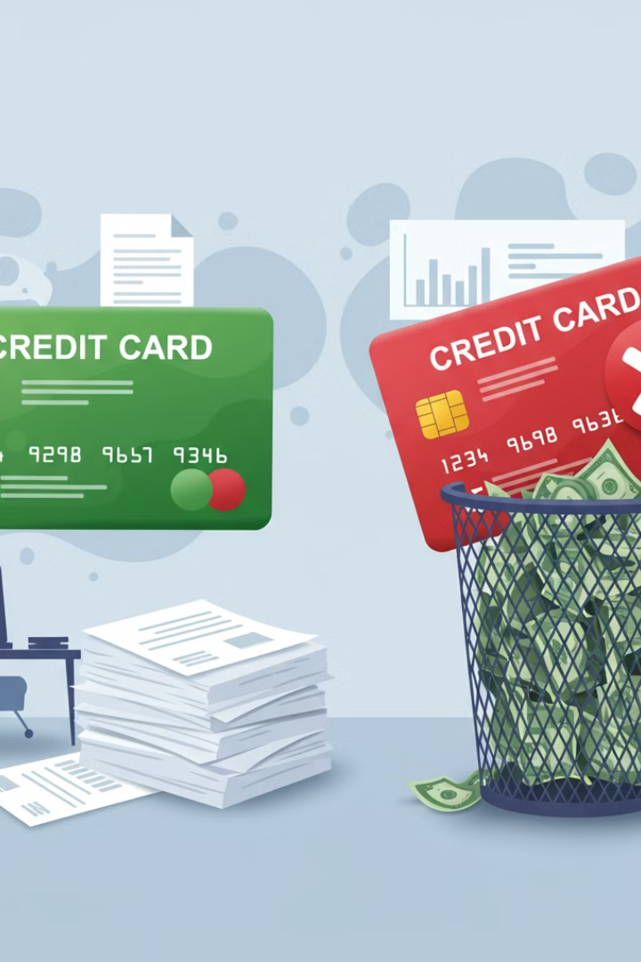
FINAL VERDICT: GOOD OR BAD?
GOOD
BAD
Credit cards are GOOD if you use them responsibly by paying your bills on time and not spending more than you can afford.
Credit cards are BAD if you overspend and don't pay your bills, leading to high debt and financial stress.
Use credit cards wisely to enjoy the benefits and avoid the risks!

